Slide 1
Snowmaking at the
Tahoe Donner
Downhill Ski Area
Based on an August 4, 2014 Presentation
to the Tahoe Donner Board of Directors
Downhill Subgroup
Hank Lewis
Butch Rohrback
Bob Heath
Robby McClendon
Miguel Sloane
Acknowledgements
Sandy McPherson – PFM Snowmaking
Jack Coughlin – Diamond Peak
Garry Morgan – Northstar
Dave Kennedy – TechnoAlpin
Nic Horgan – SMI snowmaking
Neil Kaufman – Truckee Donner PUD
Notes:
The investigation into snowmaking by volunteer homeowners and staff started in January 2014 and focused on determining the facts about feasibility and analyzing “snow season” financials (December 1 to November 30). We sought the knowledge and experience of experts in the industry and compared every reasonable alternative to reach our recommendation to the Board of Directors.

Slide 2
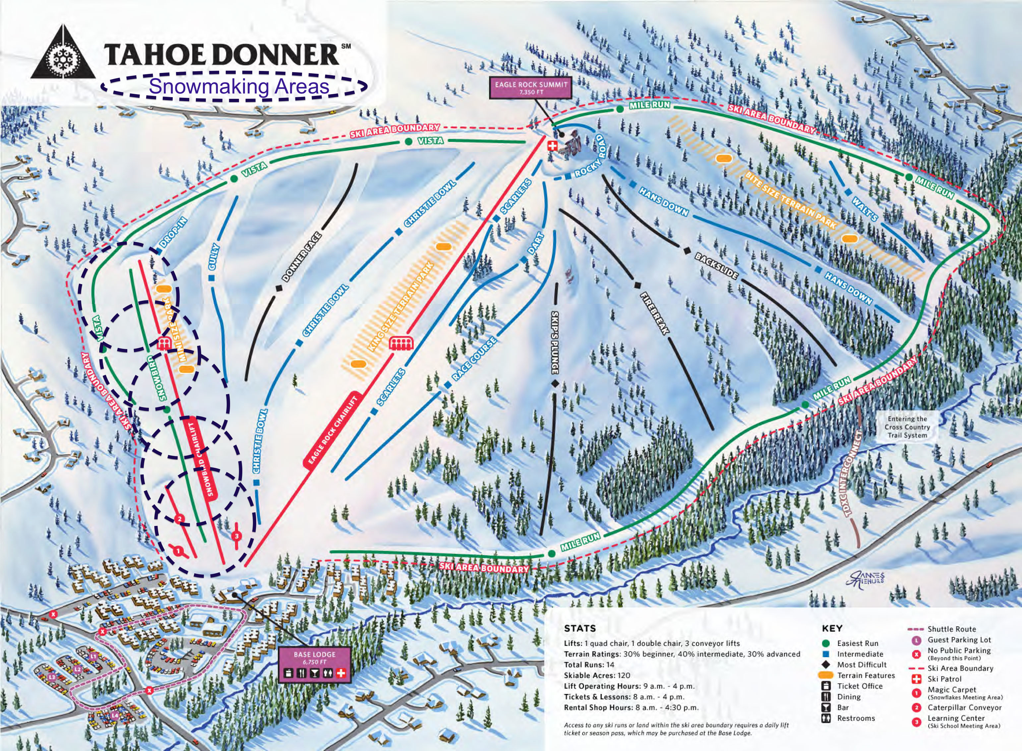
Notes:
Our plan is to provide snow coverage on the area of the ski hill that is dedicated to learning and beginner skiing. We give 3 times as many lessons per visit than the average ski area in the U.S. and our niche is “The best place to begin”. This 15 acre area requires 6,500,000 gallons of water (20 acre feet) to put down 2 feet of base over 10 days of snowmaking.

Slide 3
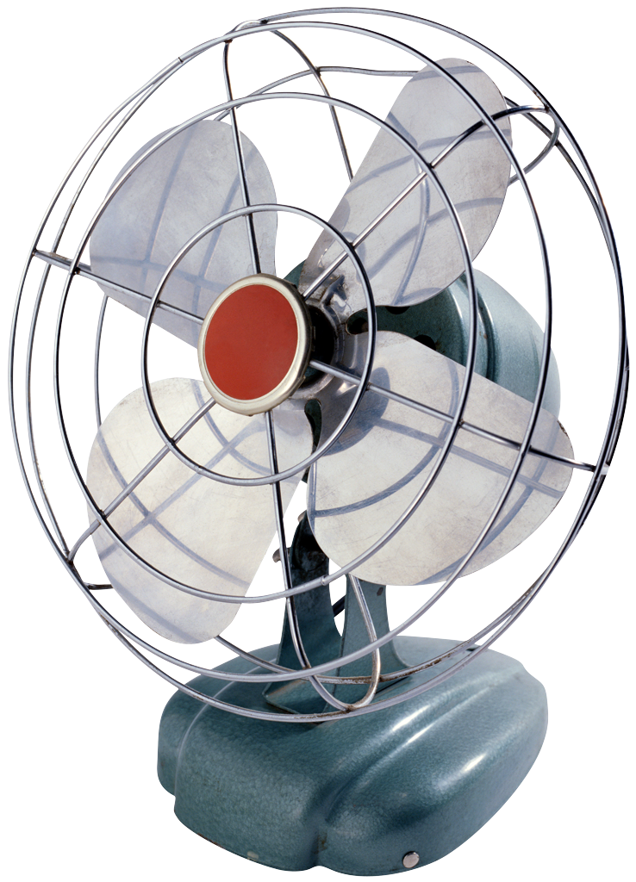
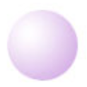
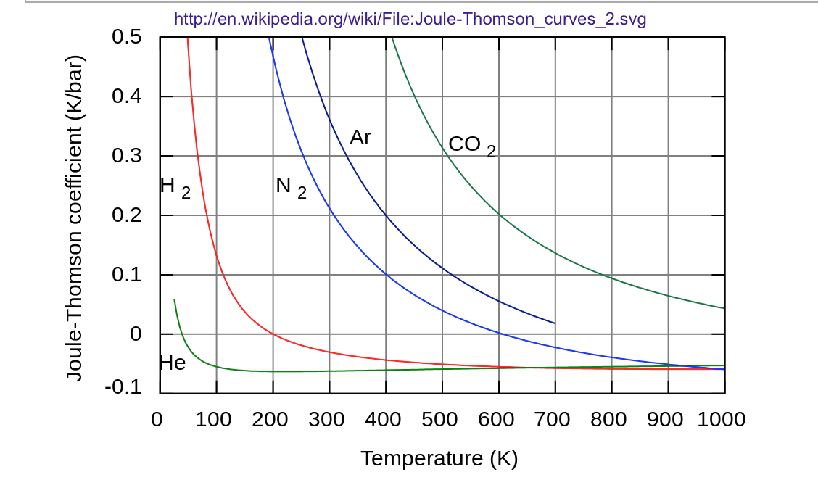
Dry Air Temperature Makes No Difference
Snowmakers use the Joule-Thompson Effect i.e. the 1st Law of Thermodynamics
Atmospheric pressure = 11 psi
27ºF ice balls
+ Evaporation Cooling
⧍H_{vap} = 540 cal/gm
⧍H_{fus} = 80 cal/gm
40 to 45ºF Water +
300 to 500 psi Air
150 ft
Joule-Thompson Equation
⧍T = µ ⧍P
Change in Temp (ºK) = J-T coefficient X Change in Pressure (atm)
Notes:
Snow guns work by a refrigeration process. When compressed air escapes through a nozzle, it cools because stored energy is released. This is how refrigerators and air conditioners work. If water is mixed with the compressed air, small ice balls are emitted from the nozzle. The snow gun sprays water on the ice balls to increase their size and when some of that water evaporates, it causes the remaining water to freeze by “evaporation cooling”. The cooling from evaporation is six times larger than the cooling needed to freeze the water. A fan in the back of the gun, propels the ice balls 150 feet out onto the ski hill and the snow gun water and electric connections allow it to be 150 feet from the connection pedestal.

Slide 4
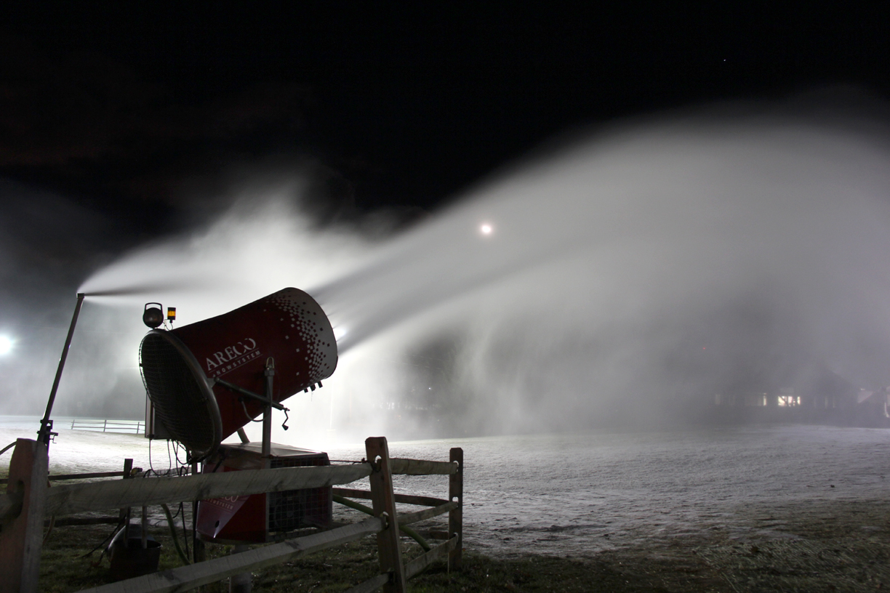
Includes compressor, weather station, microprocessor and (optional) radio communication to control station
Notes:
We plan to use fan guns like the larger one shown in this picture.

Slide 5
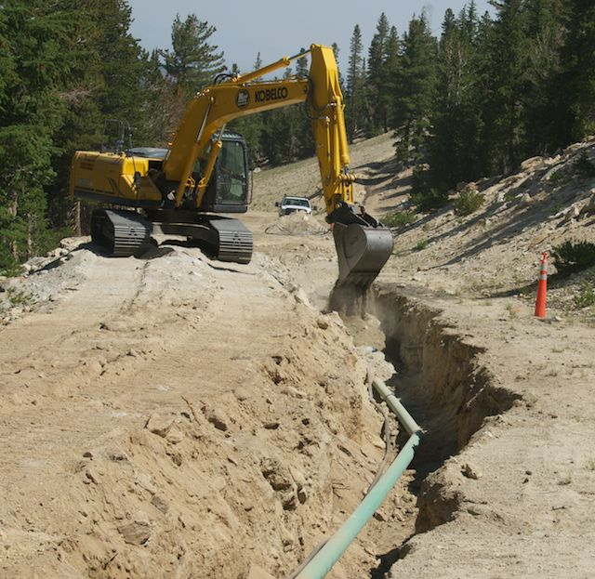
How
Snowmaking is “an irrigation system”
Trench
Lay cable, pipe & hydrants
Backfill and/or repave
Install pump house
Make Water & Electrical connections
Hook-up snow guns
Notes:
Installation would take a few weeks and involves burying a pipe and an electrical cable and providing connection pedestals every 100 feet. These lines would be underneath the chair lift. A pump house would be constructed in the woods nearby and would supply pressurized water to the system. The electric line would be connected to the same transformer that supplies electricity to the chair lift.

Slide 6
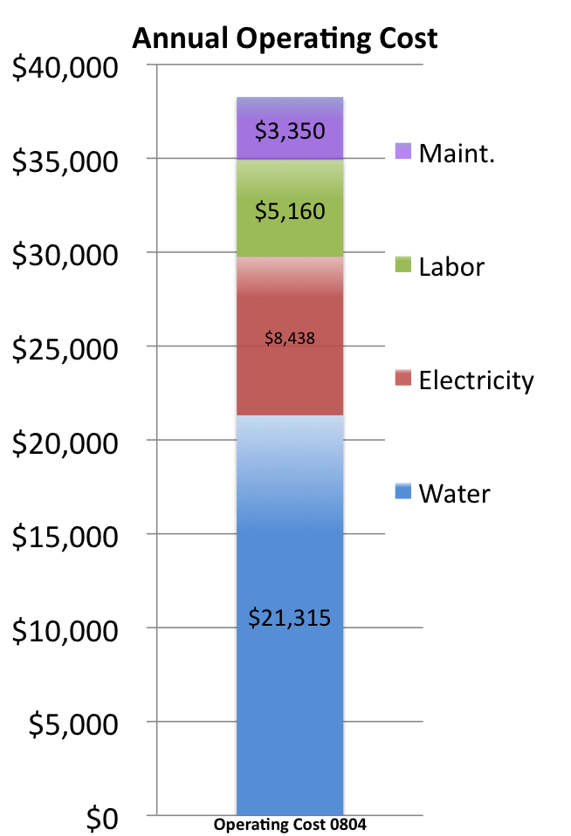
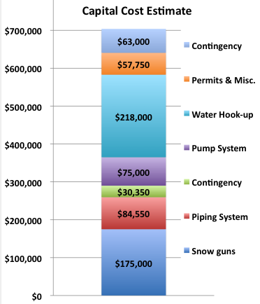
Cost Estimates
Notes:
The initial cost estimates from suppliers included a 6-inch metered valve to connect to the PUD water supply. We believe that Tahoe Donner Association already owns a valve that is not being used and can be moved to the ski hill. This may lower the capital cost.
There are 12 ski areas in the North Tahoe area that make snow. They claim that if we put down 2 feet of snow before Christmas, it will last through January even if the weather is warm and it rains. At that time, we can decide if we need to add snow for the rest of the season.

Slide 7
Feasibility
Areas of Concern
Air Temperature – ”Global climate change”
Water availability – California drought
Noise
Pollution and Permits
Notes:
People have expressed four concerns about snowmaking

Slide 8
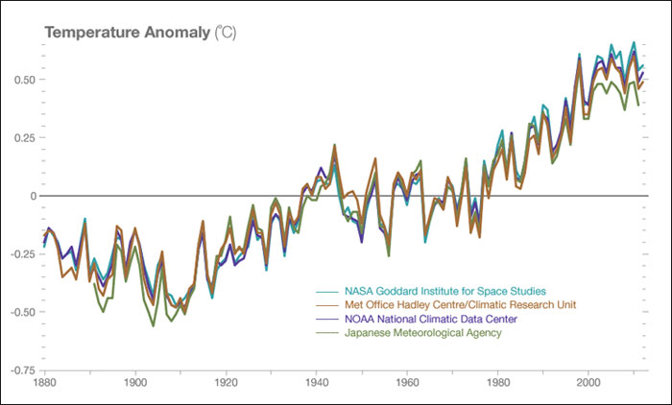
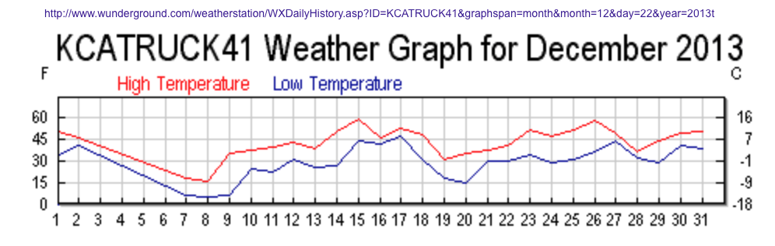
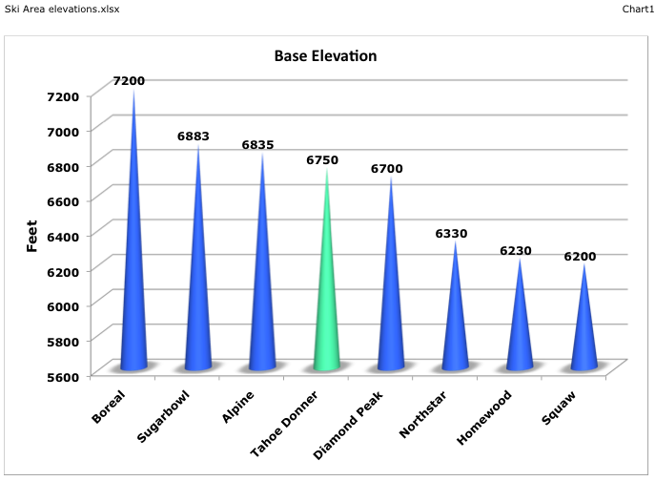
Air Temperature
Altitude
Global Climate Change
Tahoe Donner ski hill temperature
Notes:
We have a weather station on each of our chairlifts that record temperatures every 5 minutes and report on the Internet (at KCATRUCK41.com) The record going back over 5 years indicates that we have a sufficient number of cold nights in November and December to make a 15 acre snowpack 2-feet deep before the Christmas holiday. When the temperature is below freezing, and preferably in the mid-twenties, it would take 10 nights to make this much snow.

Slide 9
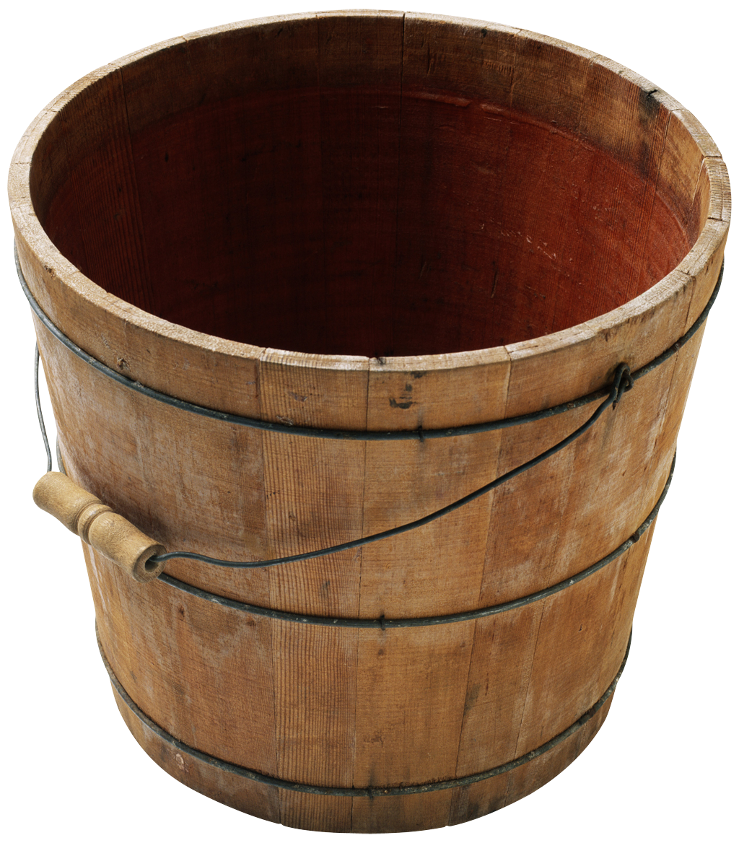
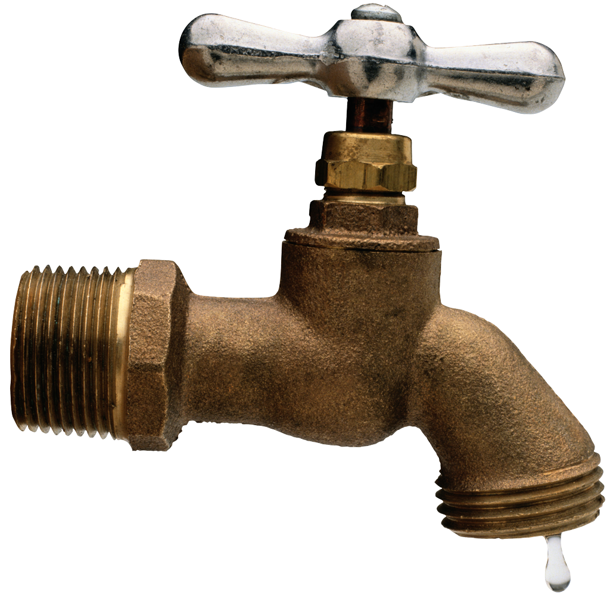
Annual inflow = 24,000 to 34,000 Acre-feet
Martis Valley
Groundwater Basin
484,000 A-ft
(> 40 years with no inflow)
TD snowmaking
20 A–ft
per season
PUD + NWD + PCWD = 9,000 A-ft
Notes:
Our water comes from the Martis Valley Groundwater Basin which is owned by three Nevada Indian tribes and leased to the three water agencies that withdraw the water for public use. The basin contains a huge amount of water compared to how much we would need for snowmaking. The PUD has assured us that they can supply the 500 gallons per minute we would need.

Slide 10
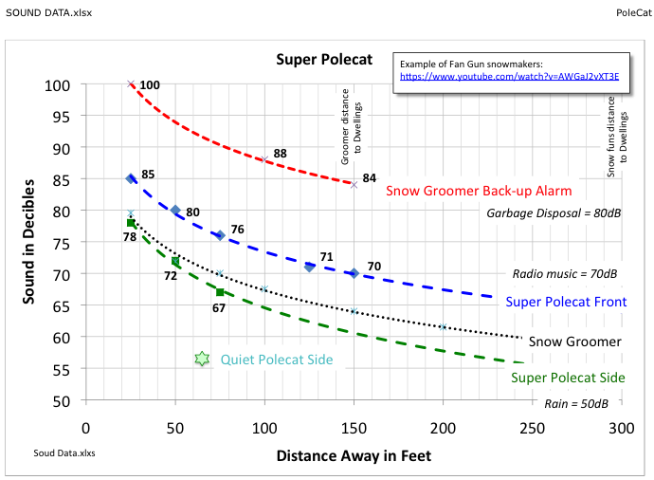
Sound Data
Notes:
Measured sound data from the manufacturers of snow guns and grooming machines indicate that the snow groomer used currently is louder than the snow guns. A trial at the ski hill in February 2015 confirmed this.

Slide 11
Pollution and Permits
Pollution
  The water is drinking water
Existing Permits
  Use Permit for snowmaking from Town of Truckee
  Lahontin Water Board - Effluent
New Permits Needed
  Tahoe Donner – Pump House Structure
  Town of Truckee
    Engineering Design & Survey
    Grading, Plumbing & Electrical permits
Notes:
When the ski hill was built, snowmaking was included in the use permit.
The snowmaking water will be drinking water from the PUD and will not include any added chemicals.
When the snow melts, the water will return to the groundwater basin.

Slide 12
Information Collected
Daily, Monthly, Yearly -
Visits by Member, Guest, Public
Rentals, Lessons, Packages
Revenue by Cost Center
  Tickets, Rentals, Lessons, Food, Retail
Expense by Cost Center
  COGS, Payroll, Opex
Weather, Days of Operation – Robbie’s Mega Spreadsheet
In other words, we have lots of data
Notes:
The team was able to draw on an extensive amount of data for its analysis

Slide 13
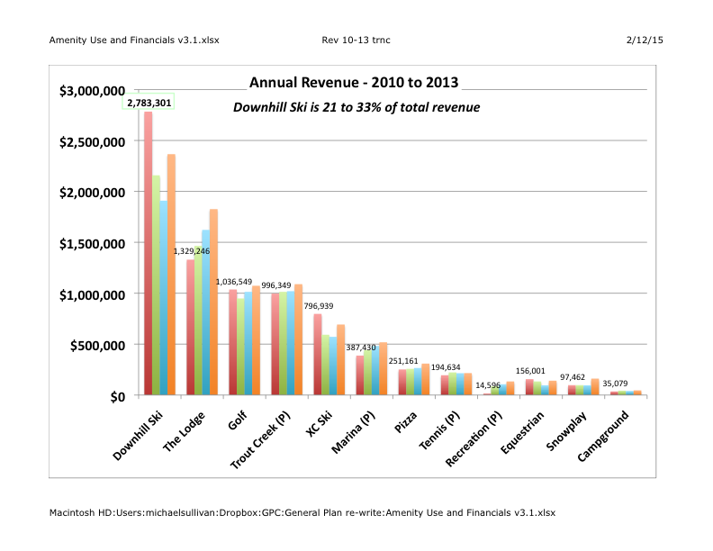
A familiar story
Notes:
The ski hill can provide up to one-third of the revenue collected from Tahoe Donner amenities and this revenue contributes one-half of the cost of operating, maintaining and improving Tahoe Donner.

Slide 14
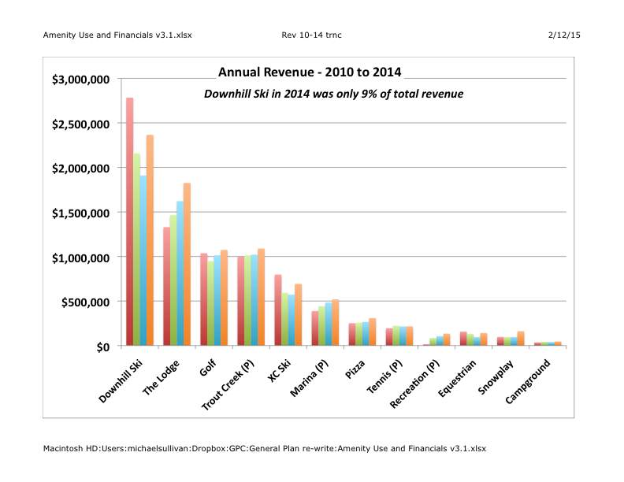
2014 was different
2014 Downhill ski revenue = $618,000
Notes:
2014 is very different from past years. Very low snowfall was only sufficient for limited operation of the ski hill, thus reducing revenue.

Slide 15
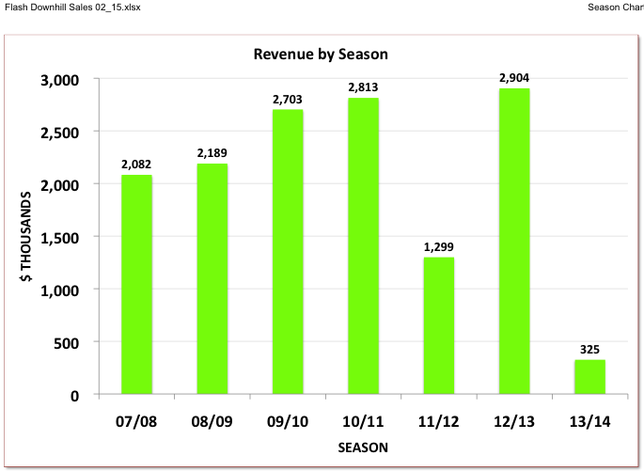
Importance of Seasonal Financials
A “Season” = December 1 to November 30
Notes:
To see the effect of snowfall, we must look at the seasonal revenue i.e. from the beginning of December to the end of November. When there was good snow, the ski hill revenue was increasing every year.

Slide 16
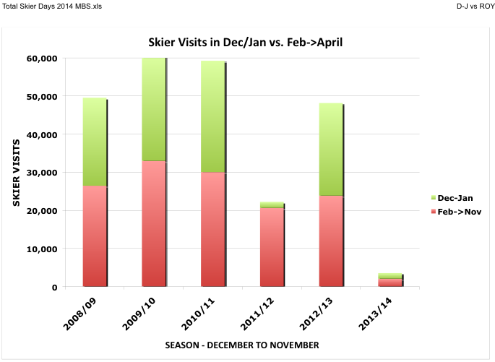
Notes:
Our niche is “the best place to begin” and we give over 4 times as many lessons per visit as the average ski area in the U.S thus school holidays bring the bulk of our skiers to the mountain. The six weeks of operation in December and January are almost 60% of the year’s revenue. If we are closed or limited at that time, the rest of the year is also impacted as seen in the 2011/12 season.

Slide 17
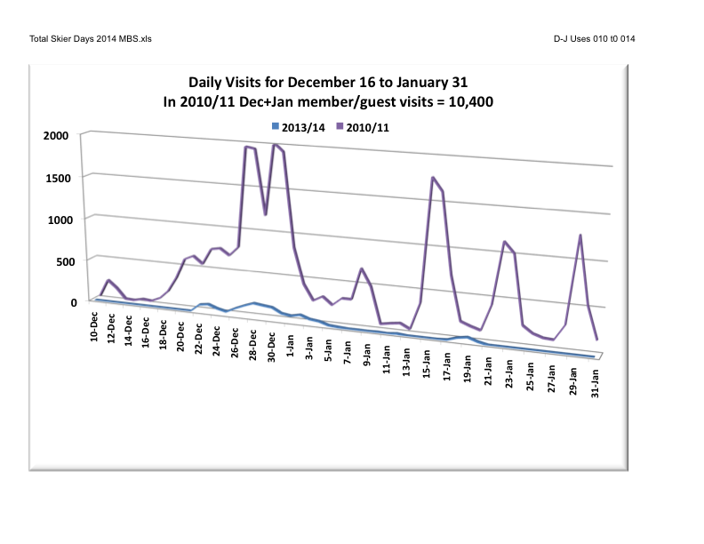
“Build it and they will come”
Notes:
We estimate that our maximum capacity is between 1,200 and 1,500 visitors per day. In our best snow years, the holiday periods have exceeded that putting a strain on our facilities and our ability to provide excellent customer service. Over 10,000 homeowners and their guests visit the ski hill in that 6-week period and there are more than twice as many public visitors. Less than 40% of revenue is ticket sales. Lessons and rentals are the bulk of revenue.
When snowfall is minimal and operations are limited we still receive several thousand visitors. These are mostly kids learning to ski. As a result, the revenue per visitor goes up almost 40% during this time.

Slide 18
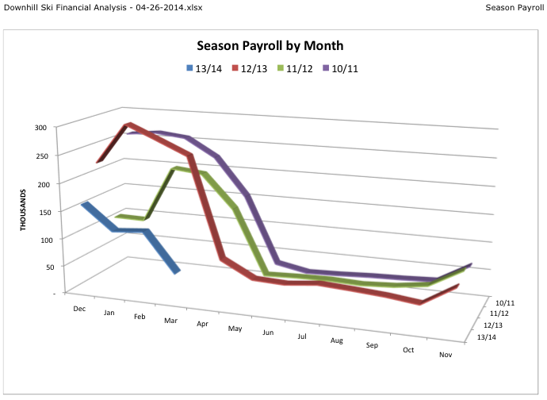
Notes:
Unfortunately, cost is not as elastic as revenue. In order to operate a ski area, it is necessary to hire and train the full compliment of staff before the season starts. If there is inadequate snowfall, the workers are laid off and must seek employment elsewhere.
Repetition of this pattern will make it harder to hire good people. Other ski areas consider snowmaking as insurance so that they can continue to operate every year. Continuity of operation and protecting the asset value of our ski area may be the most compelling reason to install snowmaking.

Slide 19
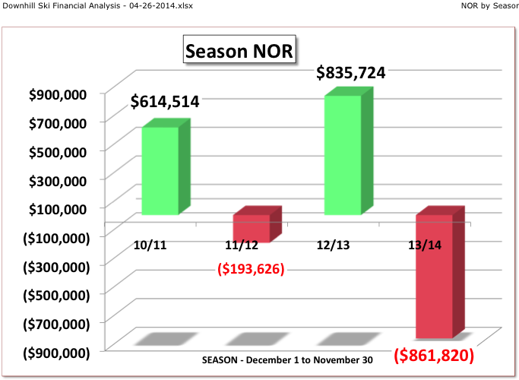
Even more important!!
Notes:
The result of low snowfall, limited operations and inelastic costs can result in a $1.7 million swing in Net Operating Results between a good snow year and a bad snow year.

Slide 20
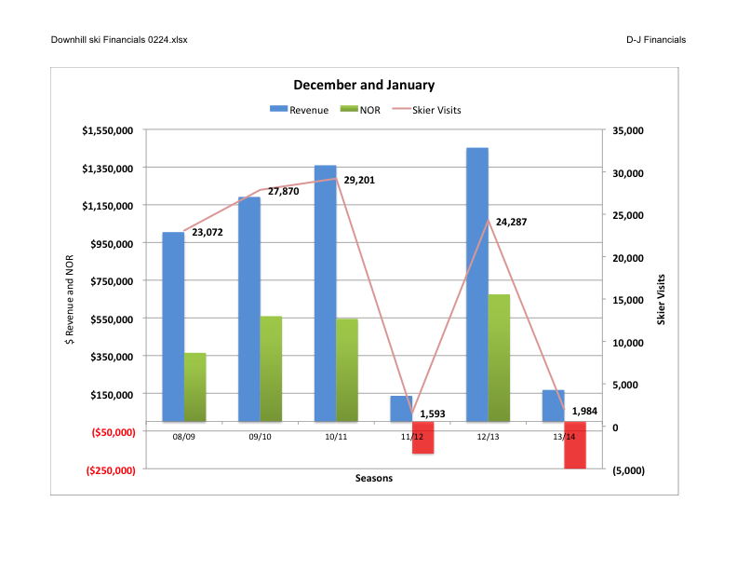
Notes:
This chart summarizes visits, revenue and Net Operating Return.

Slide 21
Summary & recommendation
Summary
  Facts show it is feasible
  Driving Forces are strong
    Continuity
    Customer Service
    Economics
Tahoe Donner Board decision
  Proceed with design & permit application
  Determine stakeholder concerns
Notes:
Our analysis shows that the concerns are not supported by the facts and that there are many strong reasons to invest in the insurance of snowmaking.
The Tahoe Donner Association Board of Directors has directed us to obtain a final design and apply for the necessary permits while simultaneously informing the Members and assessing any remaining concerns so they can be addressed by the design and by operational procedures.

